Slide 1

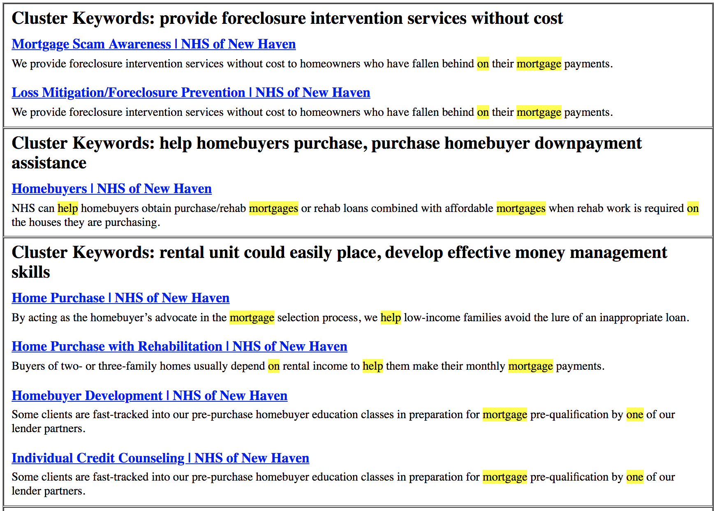

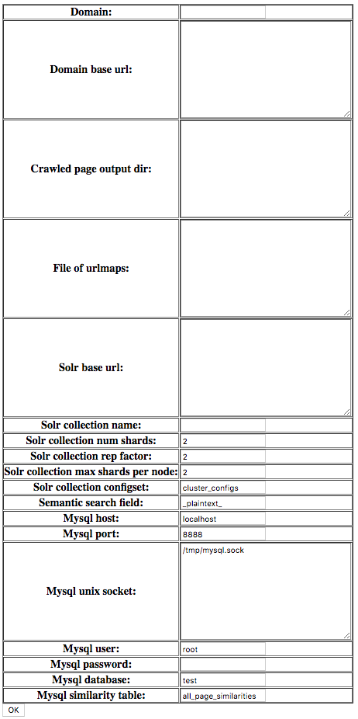
Restricted-Domain Search Engine Clustering and Summarization
Emon Datta, Dragomir Radev PhD
CPSC 490 Final Project

Slide 2
The Problem

Slide 3
Outline
The Problem
The Approach
AAN Search
Domain-Specific Search Engine
Clustering, Summarization, & Ranking
Evaluation & Results
Conclusion

Slide 4
The Approach

Slide 5
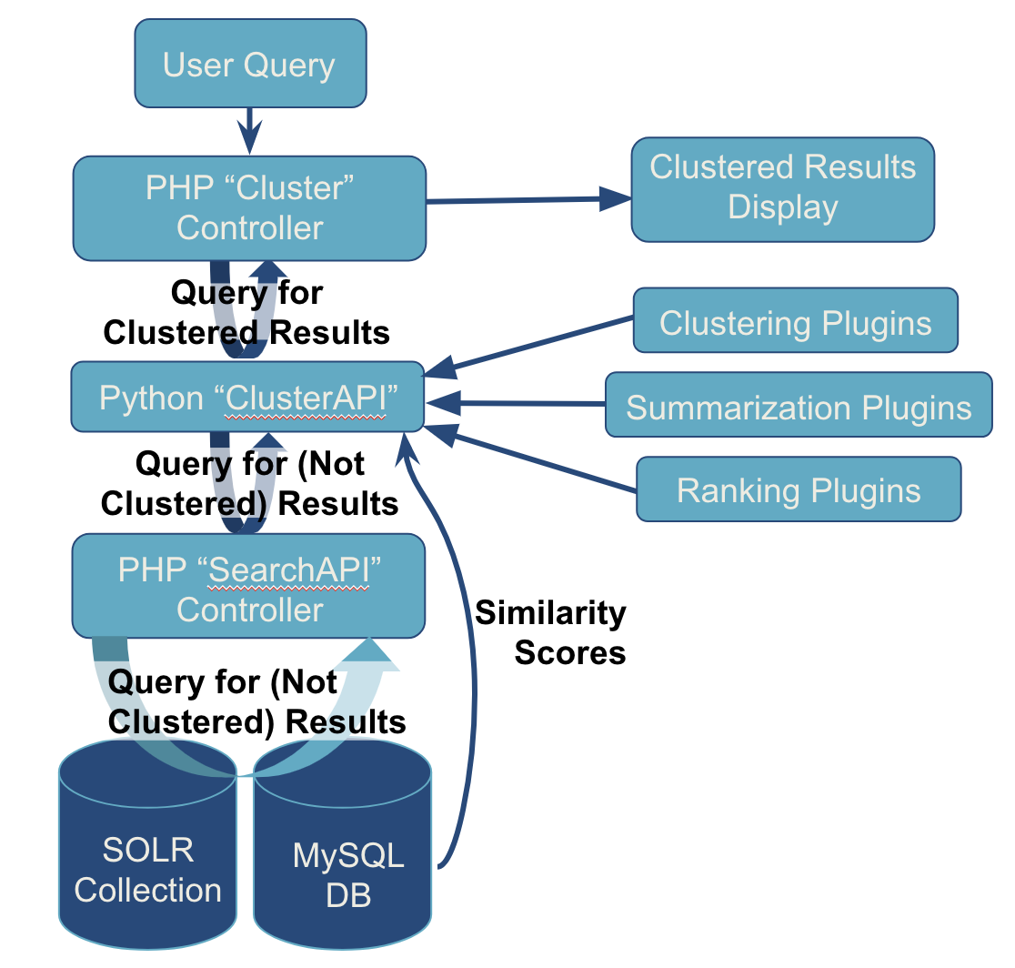
AAN:
Search & Cluster Resources
Architecture

Slide 6
AAN:
Search & Cluster Resources
Usage
Let’s try it out.

Slide 7
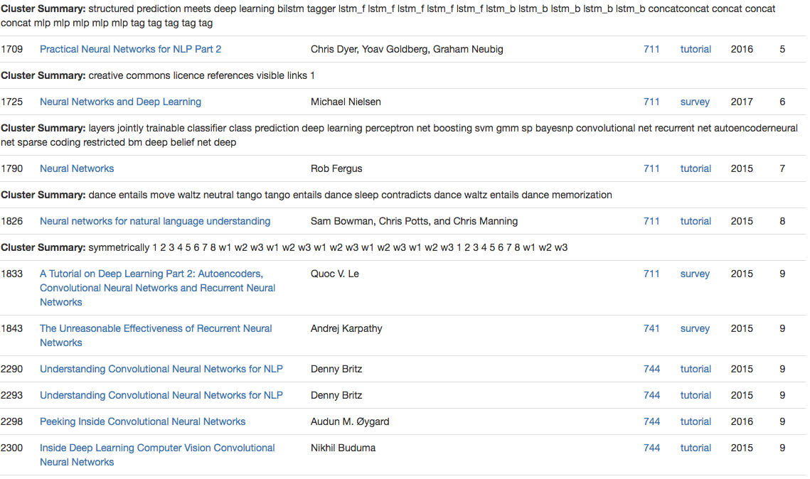
AAN:
Search & Cluster Resources
Usage

Slide 8
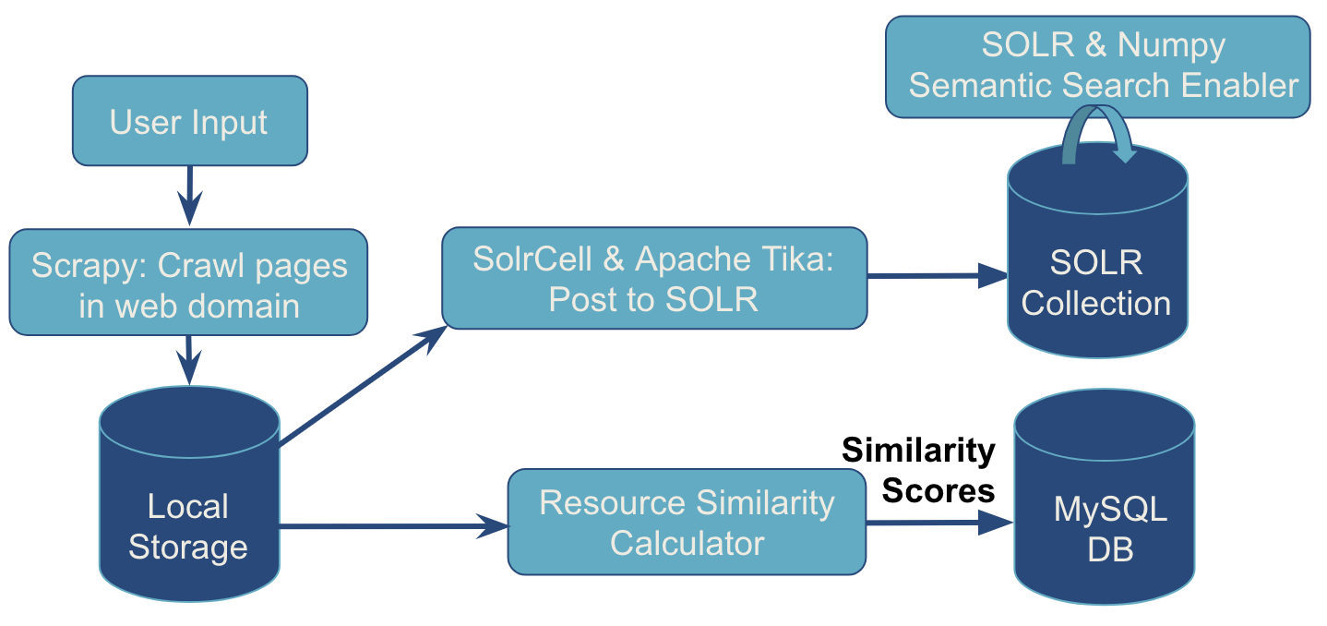
Domain-Specific Search Engine:
Indexing
Indexing Architecture

Slide 9
Domain-Specific Search Engine:
Indexing
Indexing Usage

Slide 10
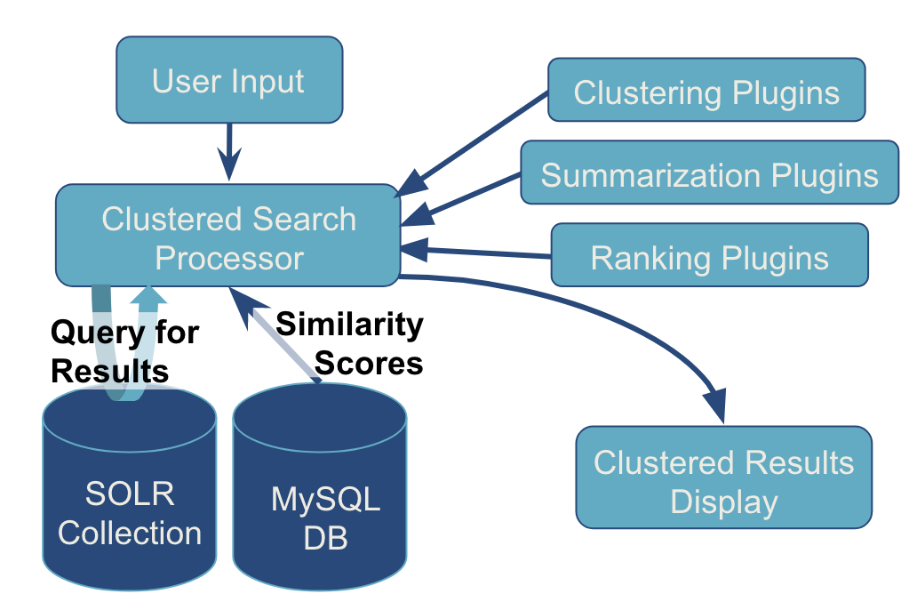
Domain-Specific Search Engine:
Clustered Search
Search Architecture

Slide 11
Domain-Specific Search Engine:
Clustered Search
Search Usage
Let’s try it out.

Slide 12
Domain-Specific Search Engine:
Clustered Search
Search Usage

Slide 13
Clustering,
Summarization, & Ranking of Results

Slide 14
Clustering
Current Plugins:
DBSCAN
HDBSCAN
Affinity Propagation
Linkage
Single Linkage Clustering
Ward Linkage Clustering
Median Linkage Clustering
Centroid Linkage Clustering,
Weighted Linkage Clustering
Average Linkage Clustering

Slide 15
Cluster
Summarization
Current Plugin:
RAKE: Rapid Automatic Keyword Extraction

Slide 16
Cluster
Ranking
Current Plugins:
max_score
median_score
sum_score

Slide 17
Evaluation & Results

Slide 18
User Survey
Clustering: DBSCAN Summarization: RAKE
Ranking: max_score
Did you think the clustered or not clustered results were more useful?
 | Clustered | Not Clustered
Query 1 | 8 | 15
Query 2 | 16 | 7
Query 3 | 13 | 10
Total | 37 | 32
Did you think the cluster keywords/summaries were useful?
 | Yes | No | Other
Query 1 | 9 | 12 | 2
Query 2 | 16 | 5 | 2
Query 3 | 10 | 11 | 2
Total | 35 | 28 | 6
Let’s take a look at the survey.

Slide 19
User Survey
Issues with Summaries and Keyphrases
Nonsensical, random, out of context
Word clutter
Can detract from clusters
Assorted Comments
“the keywords were not helpful, especially the one with post and reply [“first blog post blog blog first blog post”] several times.”
“key words were a bit confusing/random”
“cluster keywords were broken phrases presented out of context...difficult...to use them as a guide to deciding which search results would be most relevant.”
“includes unnecessary or things that were not common knowledge like naming a member or crypto preview preview (very confusing)”
“The clusters cluttered the page.”
“too many words but some extra information is nice.”
“I liked that multiple links were grouped by the same type of subject….Once again, did not really read cluster keywords”
“The cluster helped organize and get an overview of the results. The keywords made no apparent sense, however.”
Link to the survey.

Slide 20
Conclusion

Slide 21
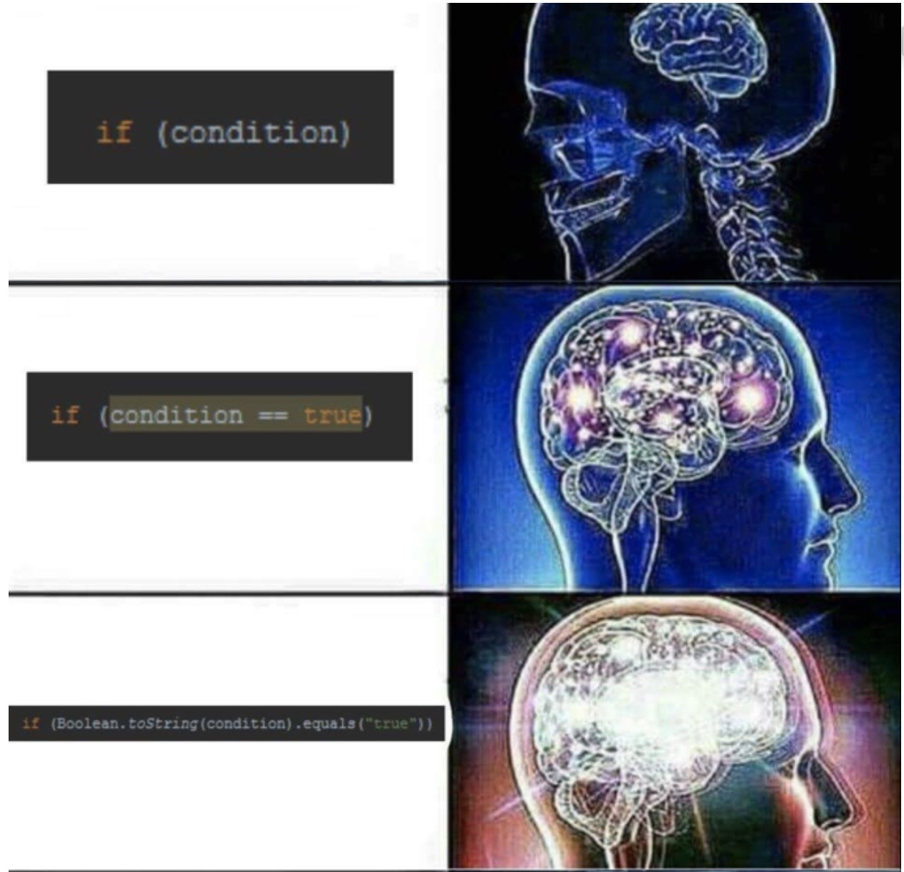
Algorithmic Improvements
Improve summarization plugins
Tailor to multi-document scenario
Parse HTML plaintext and whitespace differently
Penalize repetition (within and across clusters), non-words, proper nouns, etc.
Shorter summaries
Improve clustering plugins
Tweak parameters
Support clustering algorithms that don’t use precomputed distance matrix
Improve cluster ranking plugins

Slide 22

Other Improvements & Extensions
Support non-HTML document types
Improve error tolerance when parsing documents
Create more plugins
Utilize more robust SOLR search capabilities

Slide 23

Deployment: Looking Ahead
Clustering as optional feature
See AAN as example
Clusters without summaries or keywords
No cluster summaries
No summaries for single item “clusters”
Clustering only added to some query results

Slide 24
Questions?
Thank You!

Slide 25

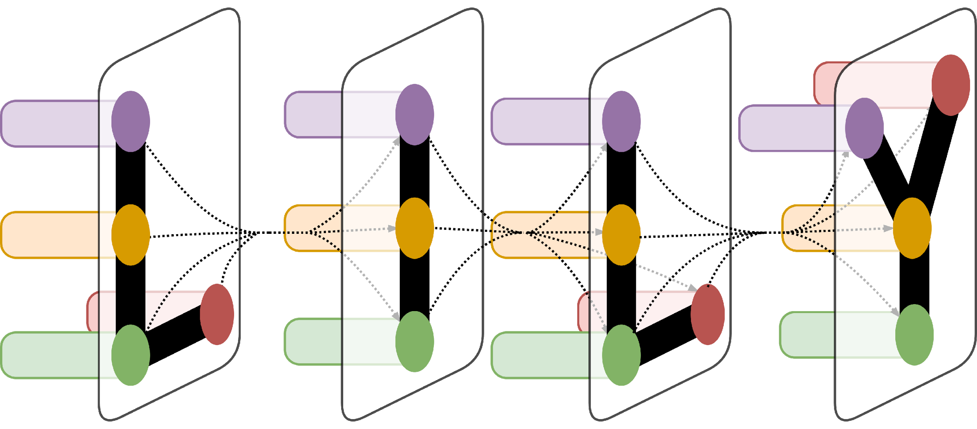
Restricted-Domain Search Engine Clustering and Summarization
Emon Datta,¹ Dragomir Radev PhD¹
¹Department of Computer Science, Yale University, New Haven, CT
LILY Lab
Introduction
User Query
Clustering, Summarization, & Ranking
This project focused on adding clustering and summarization capabilities to a search engine for a restricted document set. The first phase of the project involved adding a “Search & Cluster Resources” option to AAN’s existing search bar. The second phrase involved creating an application that, given the name and url of a web domain to search, will crawl and index its HTML pages. Users may then search within that domain and will be served ranked, clustered results with cluster descriptors. Both implementations utilized a plugin architecture for the clustering, cluster summarization, and cluster ranking so as to make these systems easy to modify and extend.
PHP “Cluster”
Controller
Clustered Results
Display
The clustering of results, summary generation of clusters, and cluster ranking functionalities were implemented using an extensible Yapsy plugin system. Clustering methods implemented were DBSCAN, HDBSCAN, Affinity Propagation, single linkage clustering, ward linkage clustering, median linkage clustering, centroid linkage clustering, weighted linkage clustering, and average linkage clustering. Summarization used RAKE with post-processing to generate keyphrases. Cluster ranking methods were max_score, sum_score, and median score (where score refers to search relevance scores). These methods rank clusters by their single highest-scoring documents, the sum of all their documents’ scores, or the median score of their documents.
Query for Clustered Results
Clustering Plugins
Python “ClusterAPI”
Summarization Plugins
Query for (Not Clustered) Results
Ranking Plugins
PHP “SearchAPI”
Controller
Similarity
Scores
Architecture
Query for (Not Clustered) Results
Figure 2. Snapshot of part of the returned clustered search results for the query “neural networks” on AAN.
Cluster Evaluation & Results
AAN: To facilitate information sharing between the PHP site and the Python code with the clustering logic, I created a REST interface. The PHP code exposes a SearchAPI which returns relevant resources’ ids mapped to their SOLR search scores. The Python code exposes a ClusterAPI which retrieves the resource list from the SearchAPI, clusters, summarizes, and ranks the clusters, and returns a mapping of each cluster to its associated resource ids and summary string. The PHP Cluster controller queries the ClusterAPI and sends the results to display. The Cluster controller specifies the clustering, summarization, and ranking plugins to use to the ClusterAPI. It currently uses to DBSCAN, RAKE, and max_score, but can be changed.
SOLR
Collection
MySQL
DB
Clustering and summarization are difficult to evaluate as there is often no direct “ground truth” comparisons. I thus decided to conduct a user study for my domain-constrained search engine. Due to time and resource constraints, I chose one set of a clustering, summarization, and ranking algorithms to test: DBSCAN, RAKE, and max_score. Participants were given three queries with the domain the search was performed upon, as well as the general goal for the search. They were provided with both the clustered and unclustered search results, and asked to answer some questions evaluating whether the clustering and summarization were helpful. See results in Figure 4.
Figure 1.1. AAN “Search & Cluster Resources” Architecture
SOLR & Numpy Semantic Search Enabler
User Input
Scrapy: Crawl pages in web domain
SolrCell & Apache Tika: Post to SOLR
SOLR Collection
Users slightly preferred clusters and found cluster summaries useful, but this was not statistically significant and highly dependent on the search conducted. One significant issue that many of the freeform comments by participants highlighted was that the cluster keyphrases were sometimes repetitive and nonsensical (one example is “first blog post blog blog first blog post”) or overly specific and not representative of the cluster (sometimes, isolated names were picked out as a keyphrase).
Domain-Specified Search Engine: To index a new website, a user simply specifies a website domain and some storage information. The application then scrapes the website’s html pages, saves the files locally (for quicker access by further processing) and posts the extracted information to SOLR. It computes page similarity scores using TF-IDF and cosine similarity (for every page pairs’ titles, urls, HTML contents, and extracted plaintext) and posts this MySQL. The application also enables semantic similarity searches for the extracted plaintext by posting the results to SOLR as an additional document field, “blurred_plaintext_.”
Similarity Scores
Local Storage
Resource Similarity Calculator
MySQL
DB
Figure 1.2. Domain-Specific Indexing Architecture
Figure 3. Snapshot of part of the returned clustered search results by the domain-specific search engine for the query “help on mortgage” on domain “nhsofnewhaven.org” using DBSCAN, RAKE, and max_score plugins.
Conclusion
User Input
Clustering Plugins
Did you think the clustered or not clustered results were more useful?
 | Clustered | Not Clustered
Query 1 | 8 | 15
Query 2 | 16 | 7
Query 3 | 13 | 10
Total | 37 | 32
This search engine with query-specific clustering, summarization, and cluster ranking plugin support enables search of a domain by just filling out a form. Especially for time-crunched organizations lacking technical expertise, a easy-to-deploy tool such as this could be a useful to augment the navigation and search experience of website visitors. However, the user survey suggests that the current methods provide variable results and should be improved for deployment. As such, it could benefit from improvements which could include new plugins, further tweaking of parameters, or additional pre/post processing of documents.
To search, the user specifies an already indexed domain, the search query, and optionally one of a selection of the implemented clustering, summarization, and ranking algorithms (defaults are DBSCAN, RAKE, and max_score). The application conducts a SOLR search for relevant documents. It retrieves the precomputed cosine similarity scores in MySQL for those documents to compute and populate a distance matrix. It passes this matrix into the specified clustering algorithm to generate clusters. These clusters are then summarized, ranked, and returned for display.
Summarization Plugins
Did you think the cluster keywords/summaries were useful?
 | Yes | No | Other
Query 1 | 9 | 12 | 2
Query 2 | 16 | 5 | 2
Query 3 | 10 | 11 | 2
Total | 35 | 28 | 6
Clustered Search Processor
Ranking Plugins
Query for Results
Similarity Scores
SOLR
Collection
MySQL
DB
Clustered Results
Display
Figure 4. Number of participant responses to the question about clustered result usefulness, broken down by query and response.
Figure 1.3. Domain-Specific “Search & Cluster” Engine Architecture
Acknowledgements
Thank you to Professor Radev for being the project advisor.

